Slide 1
How to USE the Curve trace reporting Tool ?
TUTORIAL
COMMON ERRORS
François baumy 11, 07, 2017

Slide 2
SUMMARY
This document describes ways to use the additional module/software called Curve Trace Reporting Tool.
It details :
The display
Limits calculation
The reporting part
Common errors
Before using CT-RT, make sure you have followed the documentation and the different mandatory requirements for the project creation on ACS Basic : Documentation ACS BASIC Project Creation

Slide 3
Curve Trace Reporting Tool
Advantages :
All test graphs in an unique display
Automatic report creation
Limits calculation
Deviation classification
Special view for customer complaint

Slide 4
Installation
Once the software retrieved on Collabnet or at this location : I:\TPE\06. EQUIPMENT\Curve trace system selection
Open and run the installation file.
Note : A shortcut is created in the programs menu
On the Start menu, locate the program (Curve Trace Reporting Tool).
Right-click the application’s shortcut, You must run it as an administrator
1st Method :
Click Properties.
In the Properties dialog box, click the Compatibility tab.
Do one of the following:
To apply the setting to the currently logged-on user, select the Run This Program As An Administrator check box, and then click OK.
To apply the setting to all users on the computer and regardless of which shortcut is used to start the application, click Change Setting For All Users to display the Properties dialog box for the application’s .exe file, select the Run This Program As An Administrator check box, and then click OK twice.
2nd Method :
Click Run as Administrator
Choose a backup location for limits, reference curves and graphs.
Note : This step creates a backup folder and 3 subdirectories (Limits, Ref, Fig). In these folders will be saved limits and reference curves in excel format, graphs in PNG format.

Slide 5
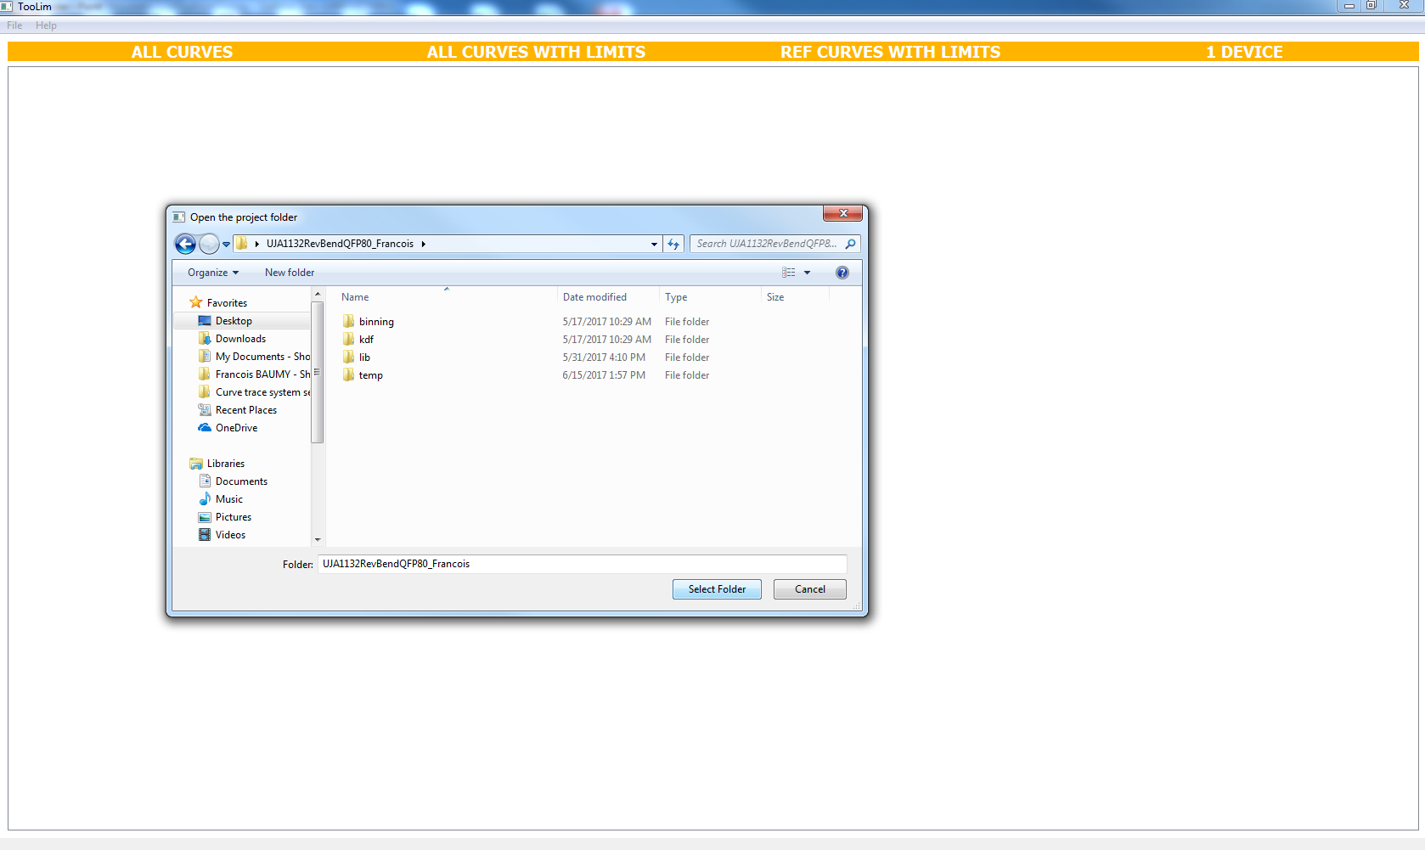
Open an ACS BASIC Project
Click on File, Open
Then, select an ACS BASIC Project in your C drive or the network.
Note : It’s better and faster to use a project saved on the C drive.

Slide 6
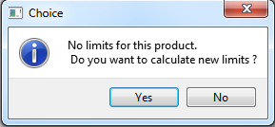
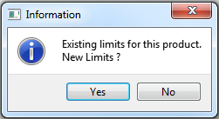
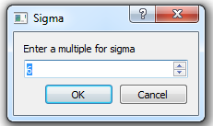
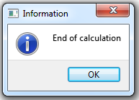
Limits and reference curves calculations (Or Not)
One of both informative windows must appear :
Choose if you want to calculate limits and reference curves or not.
If yes,
Select a sigma value.
Note : Between 4 to 9
Then, press OK
If no, and there are no previous saved limits, you can only use the “All Curves” tab in the main interface. For the printing, you can only select “All Curves” or “Selection”.
If no, but there are previous saved limits, you can use any tab in the main interface. For the printing, you can select any proposal.
For more information about limits calculation, see the documentation : New CT System additional modules Slides

Slide 7
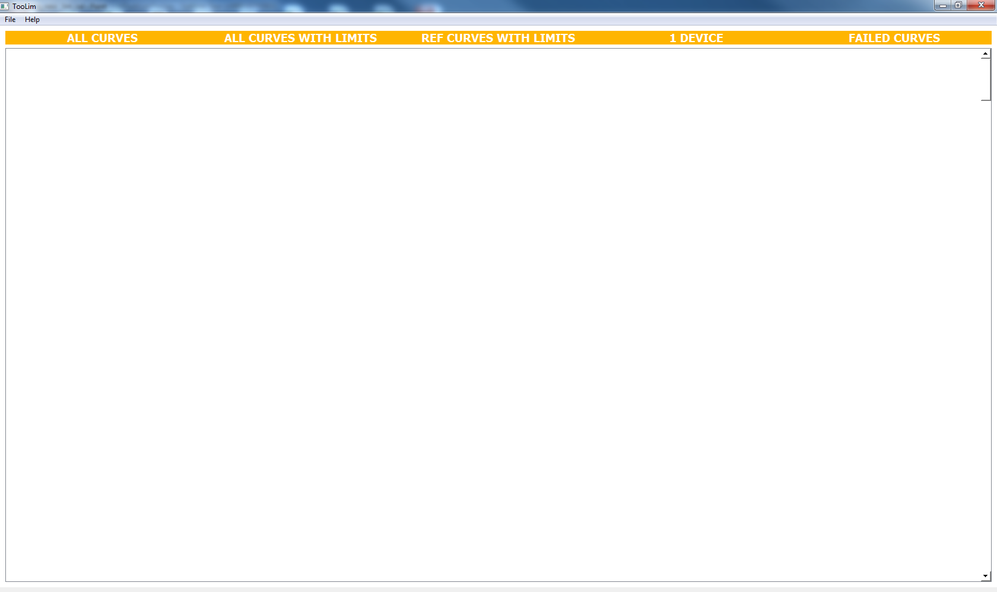
Display
Once calculations have been completed,
Choose a tab
All curves
All curves with limits
Reference curves with limits
1 device curves
Failed curves

Slide 8
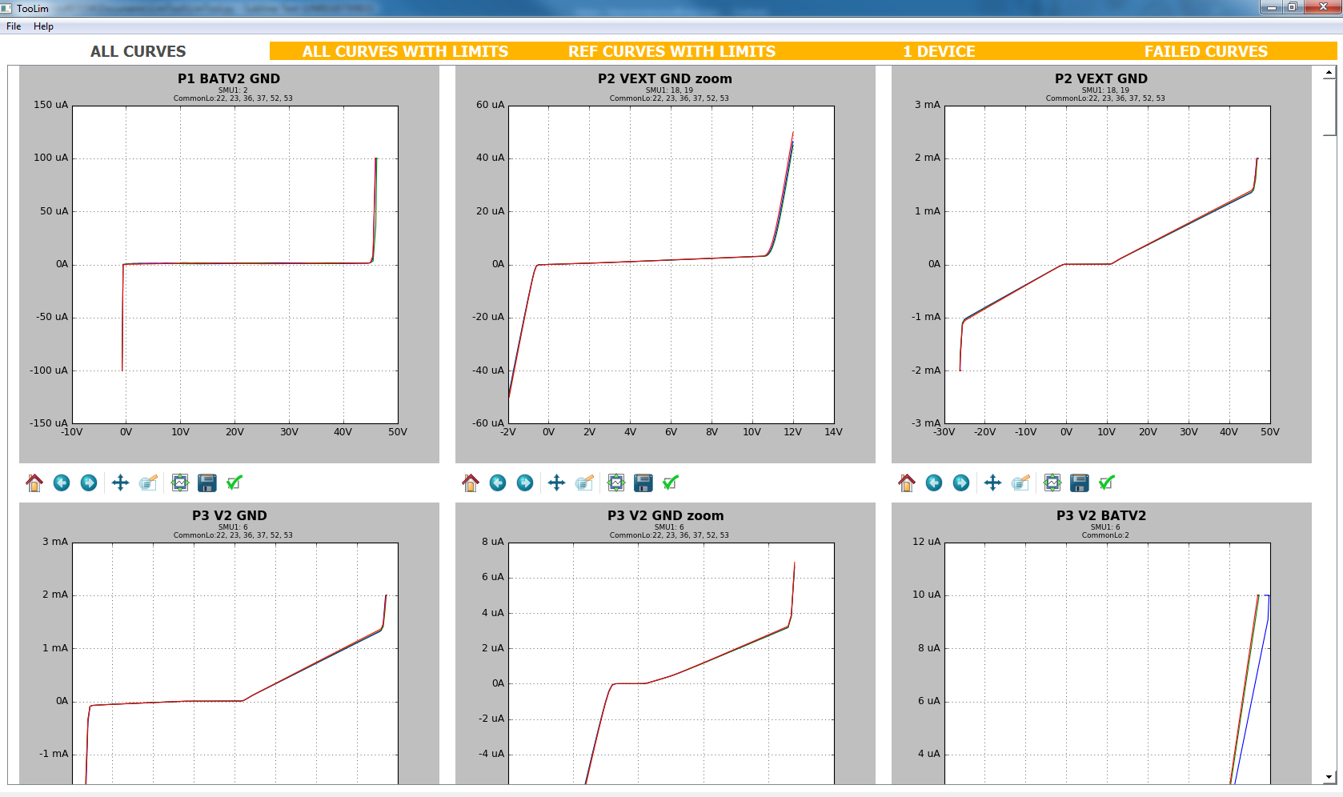
All Curves

Slide 9


Legend & Toolbar
Each graph has the same window with the test name and the pins configuration.
Note : If there is a bias connected to a SMU, you can see the bias value bracketed.
Below the graph, there is a toolbar allowing some changes.
Test name
Connected pin(s) to SMU2
3V-bias on SMU2
Connected pin(s) to SMU1
Connected pin(s) to GND
Zoom-to-rectangle
Forward
Save the figure in another location
Home
Figure options (color, linewidth, draw style, …)
Back
Pan/Zoom
Layout

Slide 10
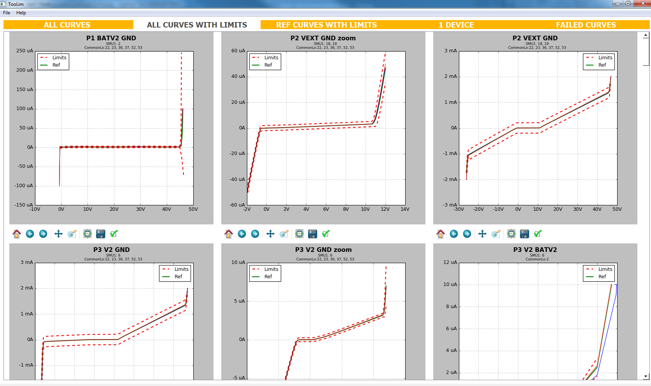
All curves with limits

Slide 11
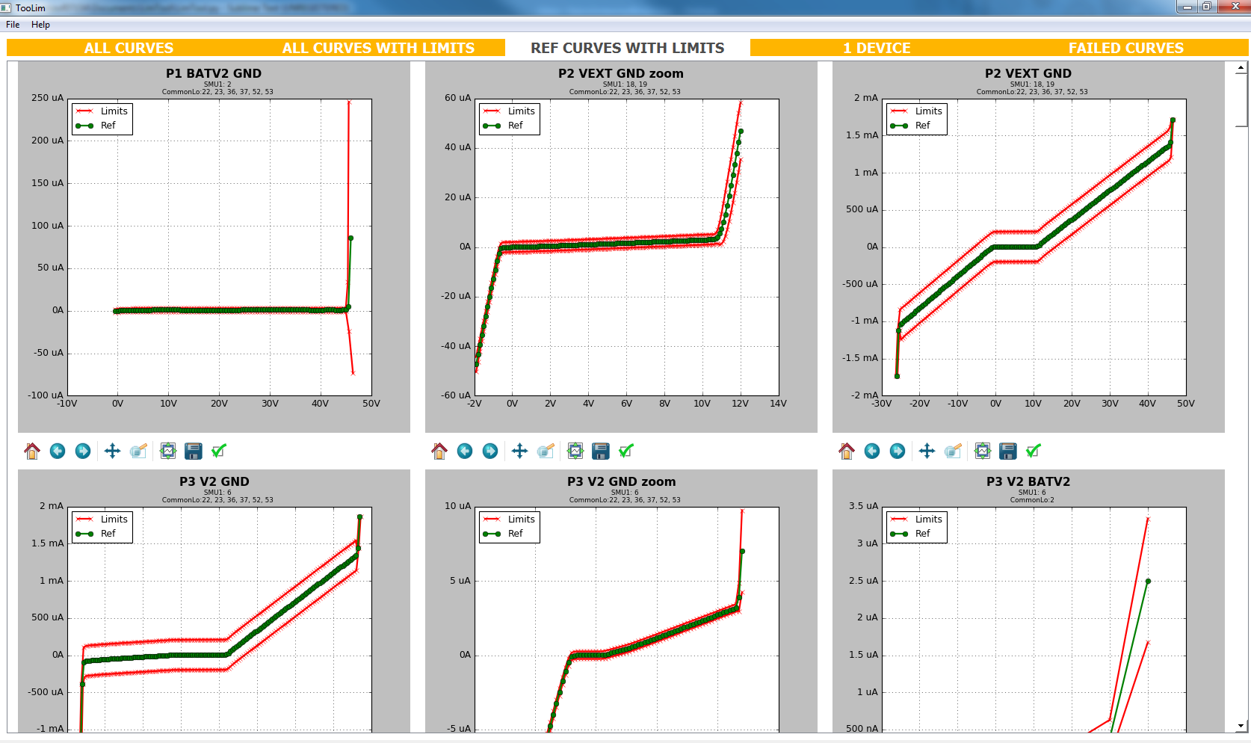
Reference curves with limits

Slide 12
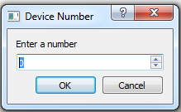
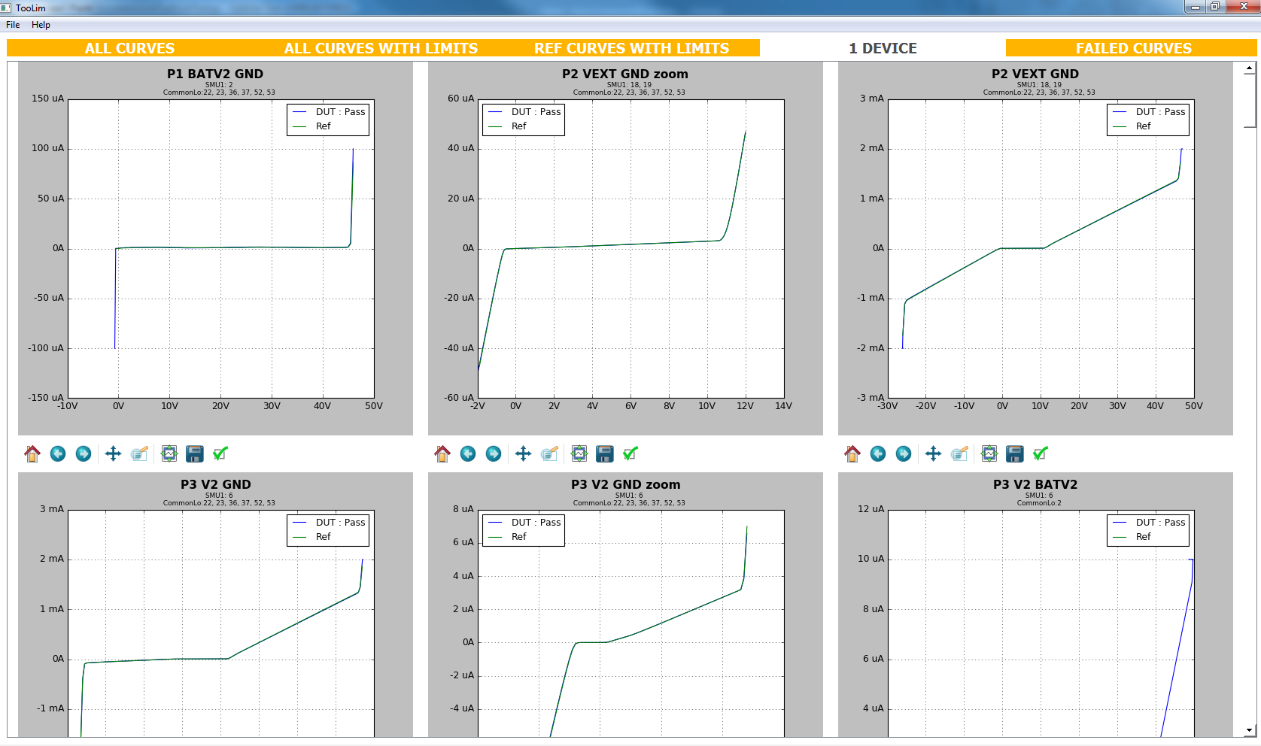
1 Device curves (1/2)
If you just want to see all tests for only a device
Press the 1 Device tab.
Enter the Append number corresponding to the desired device
Note : Append numbers start at 0.
Then, wait for the graphs loading
In the legend, you see the deviation classification of your DUT for each test.
Deviation classifications are the following :
Pass, Leak P, Leak N, Leak PN, Deviation, Short, Open

Slide 13
1 Device curves (2/2)

Slide 14
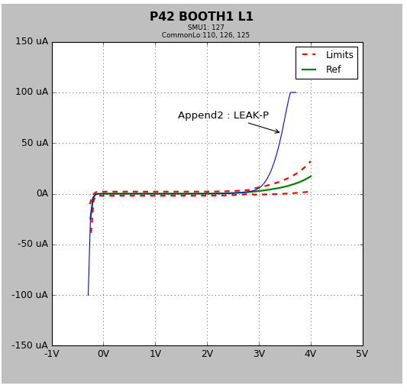
Failed curves (1/2)
If you want to see only failed curves,
Press the Failed Curves tab
Then, wait for the graphs loading
By clicking on a curve, you will make an annotation appear. This annotation tells you about the append number and the deviation classification.
Note : The append number 0 corresponds with your first DUT.
An informative window pops up if there is no failed curve. Otherwise, scroll down to see failed curves.

Slide 15
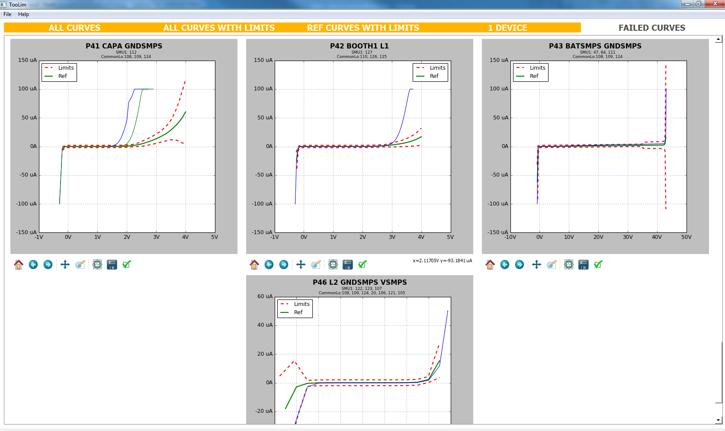
Failed curves (2/2)

Slide 16
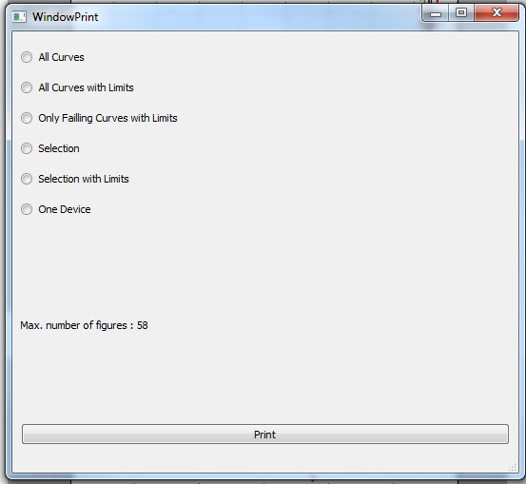
Printing interface (1/4)
If you want to make a report.
Click on Edit Report in the menubar
The printing interface should appear.
Choose one of the proposals
Note : You must have seen the related graphs on the main interface before editing the report. Indeed these graphs are saved in a folder when you open the related tab on the main interface (It overwrites the folder). Otherwise, the folder containing figures is empty or filled with previous figures.

Slide 17
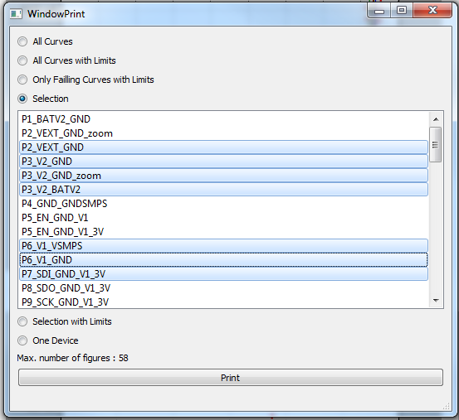
Printing interface (2/4)
You have different proposals for your report :
All curves
All curves with limits
Failed curves with limits
Selection (make your own tests selection)
Selection with limits (make your own tests selection)
One Device (related test curves of your choice in the main interface)
Note : by selecting One Device proposal, you must have chosen the desired device with the One Device tab of the main interface.
Then, click on Print

Slide 18
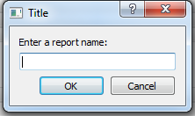
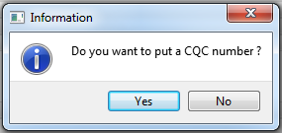
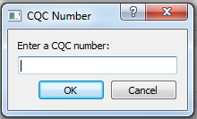
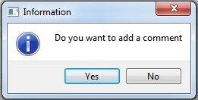
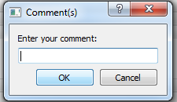
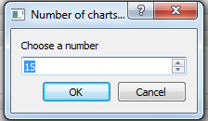
Printing interface (3/4)
Choose the saving location.
Enter a report name.
Note : This name is also the title of the PDF
Choose if you want to put a CQC number and enter it.
Choose if you want to add comment and enter it.
Note : The comment size is limited
Then, choose the number of charts per page.
Wait for the PDF opening

Slide 19
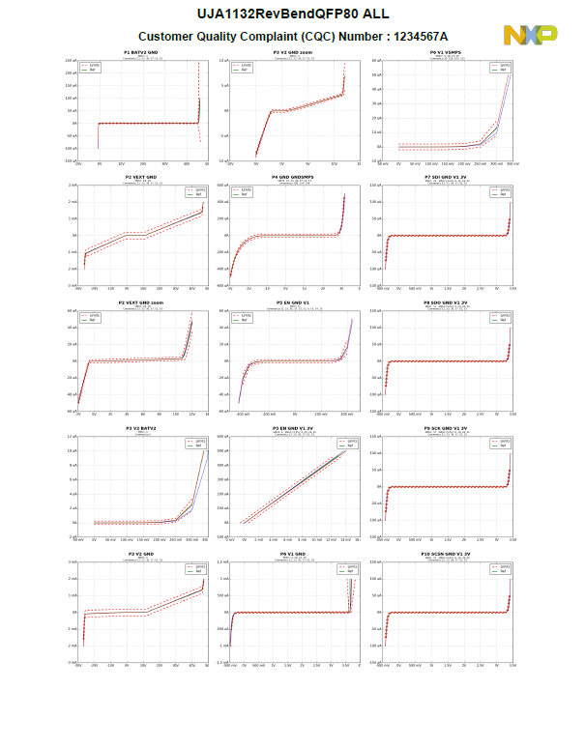
Printing Interface (4/4)
Here is an example of a report with a title, a CQC number and 15 charts per page.

Slide 20
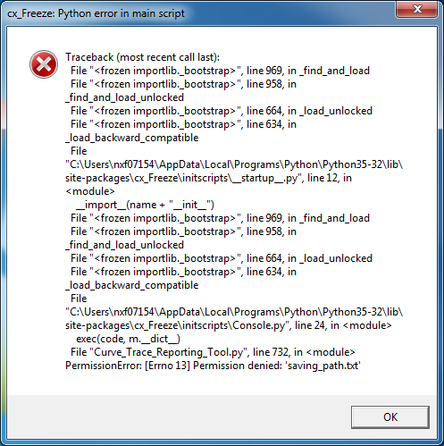
COMMON ERRORS and INFORMATIVE WINDOWS (1/4)
Cx_Freeze Python error in main script
This window pops up when the software is not as an administrator.
Right-click the application’s shortcut, and then click Properties.
In the Properties dialog box, click the Compatibility tab.
Do one of the following:
To apply the setting to the currently logged-on user, select the Run This Program As An Administrator check box, and then click OK.
To apply the setting to all users on the computer and regardless of which shortcut is used to start the application, click Change Setting For All Users to display the Properties dialog box for the application’s .exe file, select the Run This Program As An Administrator check box, and then click OK twice.

Slide 21
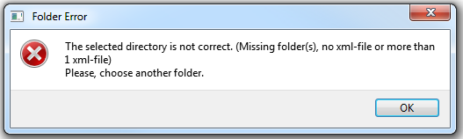
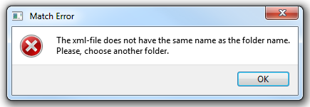
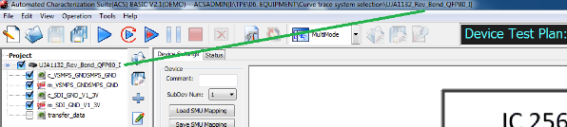
COMMON ERRORS and INFORMATIVE WINDOWS (1/6)
Folder error
This window pops up if the chosen project/directory does not have the correct subdirectories (lib and temp subdirectories must be inside), no xml file or more than one xml file.
Please, have a look to the documentation and different requirements for the project creation on ACS BASIC. (Documentation ACS Basic Project Creation)
The software can not continue and calculate limits, you must choose another folder.
Match error
This window pops up if the project name and the device name on ACS Basic are not the same. (See below)
The software can not continue and calculate limits, you must rename the project (rename the directory or the device name) in order to have the same name both. Otherwise, you can choose another folder.

Slide 22
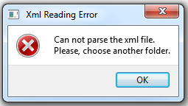
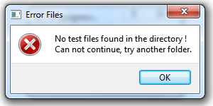
COMMON ERRORS and INFORMATIVE WINDOWS (2/6)
XML Reading Error
This window pops up if the software has a problem to parse the XML File.
The software can not continue the process, you must choose another folder/project.
Error Files
This window pops up if there are no data files in the temp subdirectory.
The software can not continue and calculate limits, you must choose another folder/project.

Slide 23
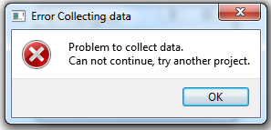
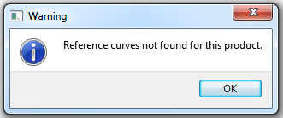
COMMON ERRORS and INFORMATIVE WINDOWS (3/6)
Error Collecting data
This window pops up if the software can not collect all the data from the temp directory. Possible causes : test name different between the c-file and the m-file(rename the m-file or the c-file), no append file found (make the test again on ACS Basic), empty file.
The software can not continue the process, you must choose another project.
Warning Reference Curves
This window pops up if there are no reference files for the project.
You must select another tab.

Slide 24
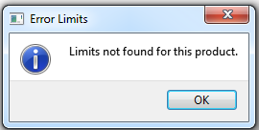
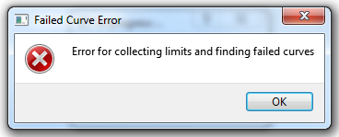
COMMON ERRORS and INFORMATIVE WINDOWS (4/6)
Warning Limits
This window pops up when there are no limits files for the project.
Choose another tab in the main window.
Note : If there are no previous saved limits, you can only use the “All Curves” tab in the main interface. For the printing, you can only select “All Curves” or “Selection”.
Failed Curve Error
This window pops up when the software can not collect limits and reference curves for the project.
It can also appear if the software has a problem to find failed curves. Maybe one of tests does not have calculated limits or reference curve.
Try to calculate new limits or choose another project.

Slide 25
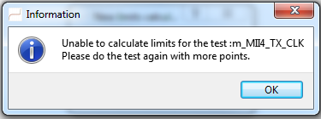
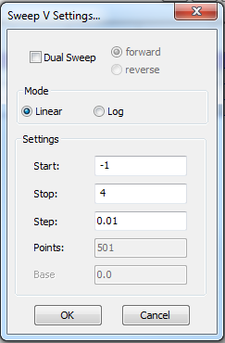
COMMON ERRORS and INFORMATIVE WINDOWS (5/6)
Unable to calculate limits
This window pops up when there are not enough points to calculate limits (Min 3 points).
Please open ACS Basic and reduce the sweep step in order to increase the number of points. Then, do the test again.

Slide 26
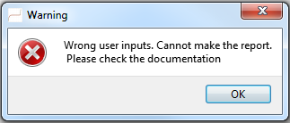
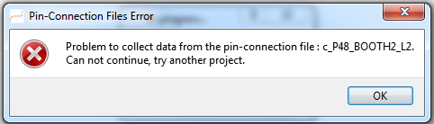
COMMON ERRORS and INFORMATIVE WINDOWS (6/6)
Wrong user inputs
This window pops up when you try to edit a report without first clicking the appropriate tab. You must have seen the related graphs on the main interface before editing the report. Indeed these graphs are saved in a folder when you open the related tab on the main interface. Otherwise, the folder containing figures is empty or filled with previous figures.
Can also pop up if there is no title or a wrong backup location.
Pin-Connection Files Error
This window pops up when there is a problem to collect data from the pin-connection files. Possible causes : empty data file, missing file.
Try to fix this problem on ACS Basic by running the test again.

